Slide 1
User ID
PIN

Slide 2
Settings
Settings
Sun, 12 Feb
28
Day and date
Access next day’s clients
Access previous day’s clients
How many clients for that day
Name – 30 min
Address
06:00
Boxes that can be clicked on (see next slide)
Name – 1 hour
Address
07:00
Last time when it was refreshed
Last Synced on 12 Feb 2023 18:00
Refresh button

Slide 3
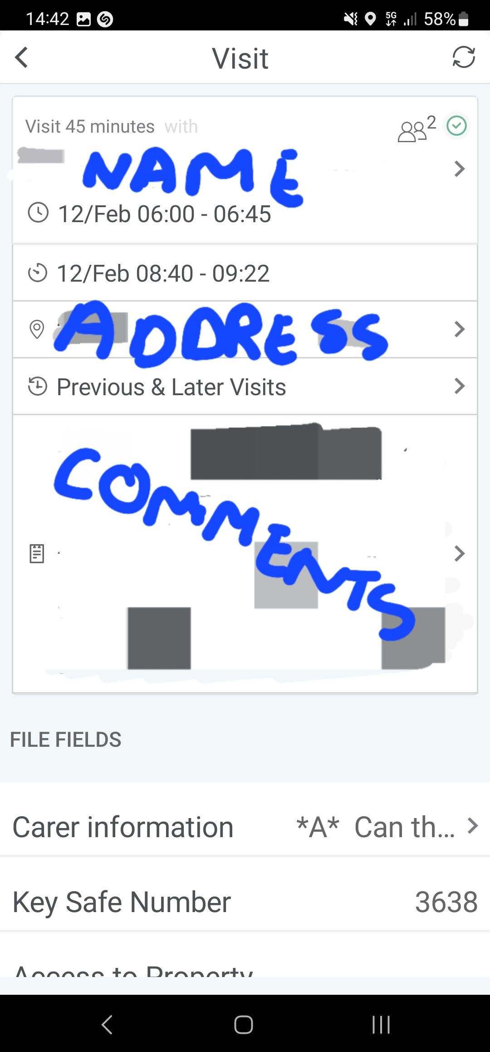
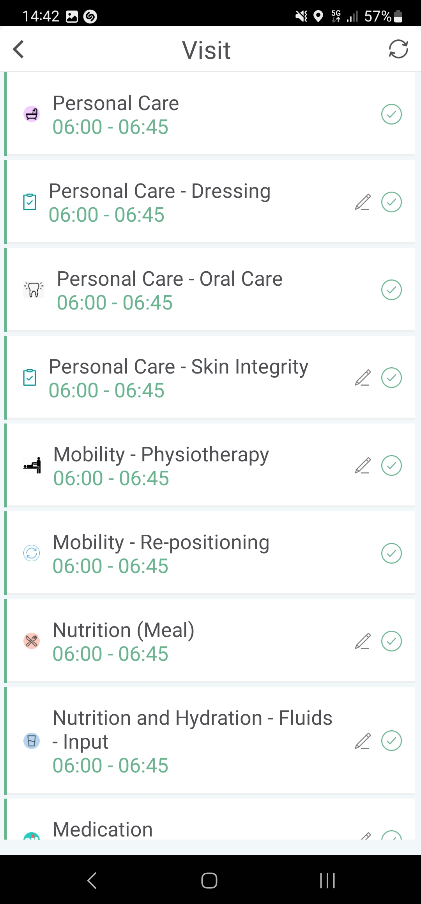
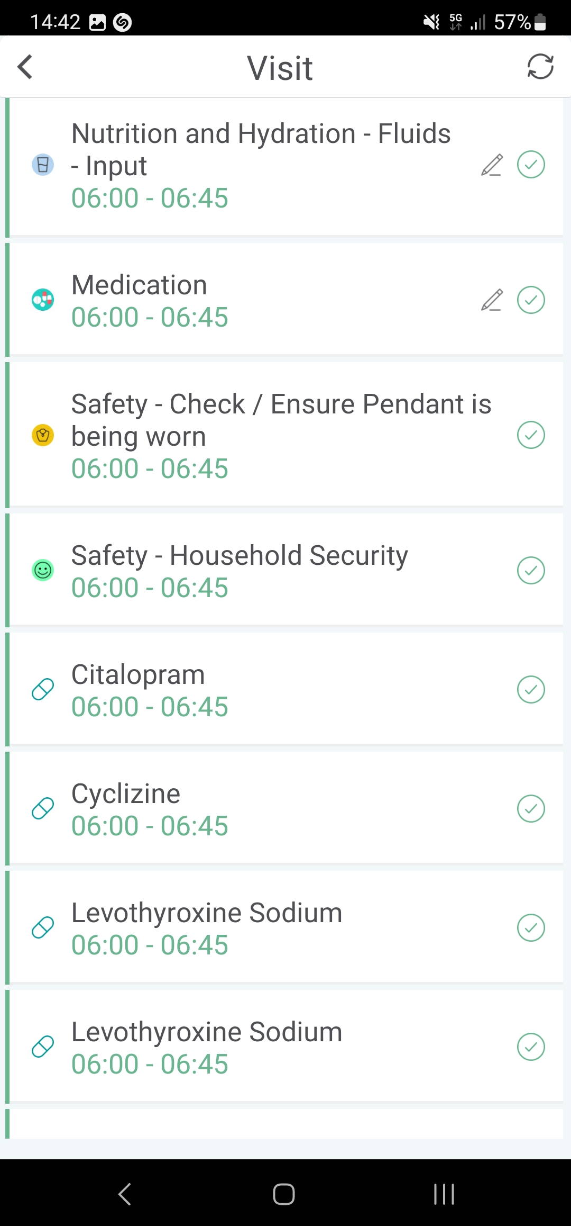
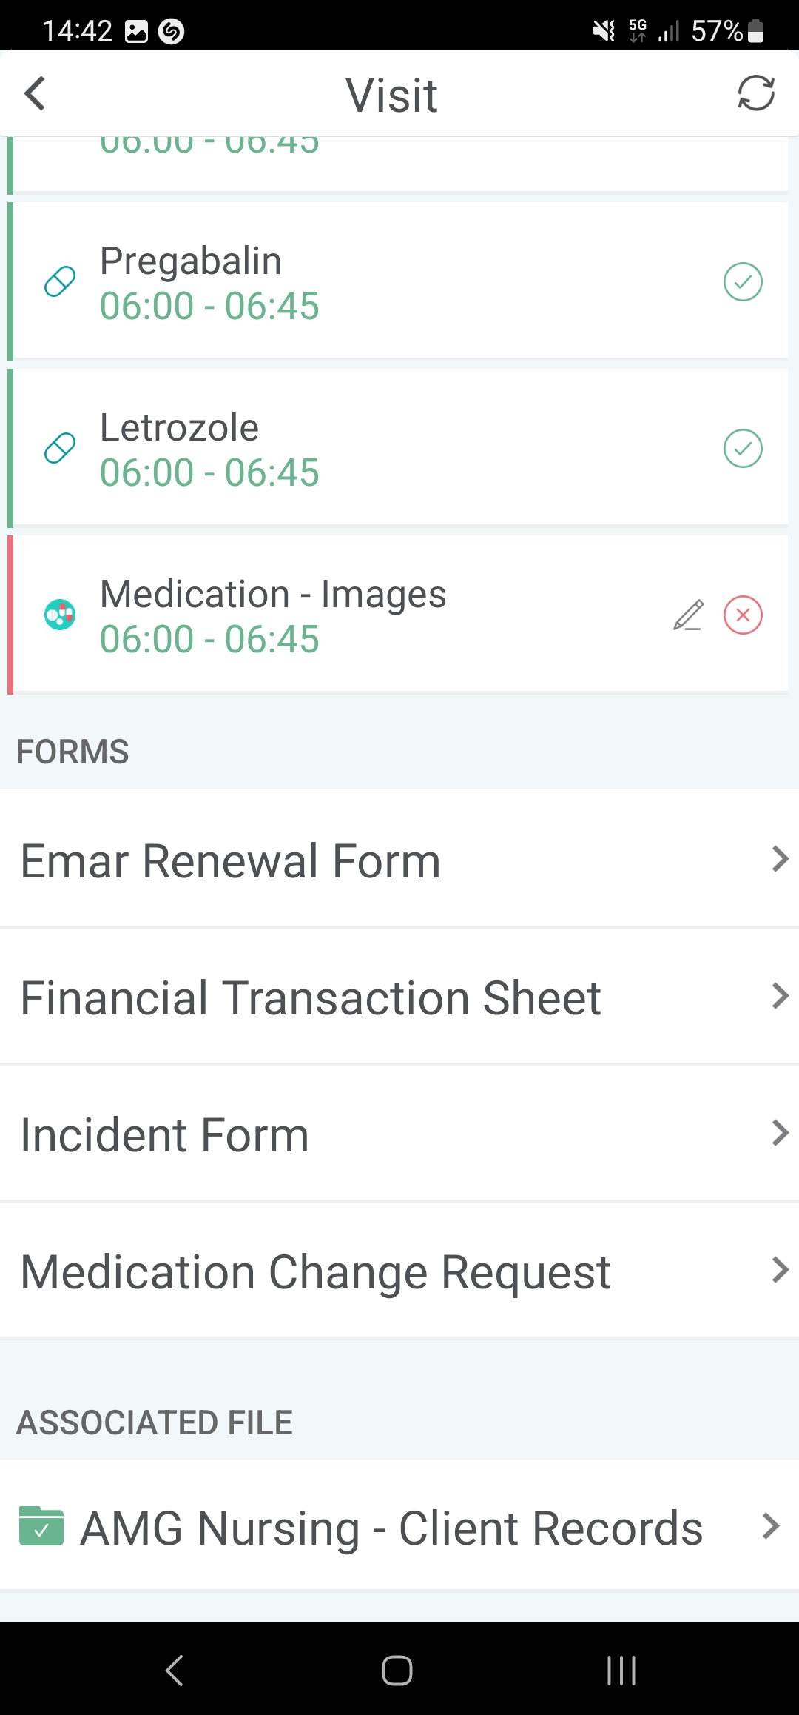
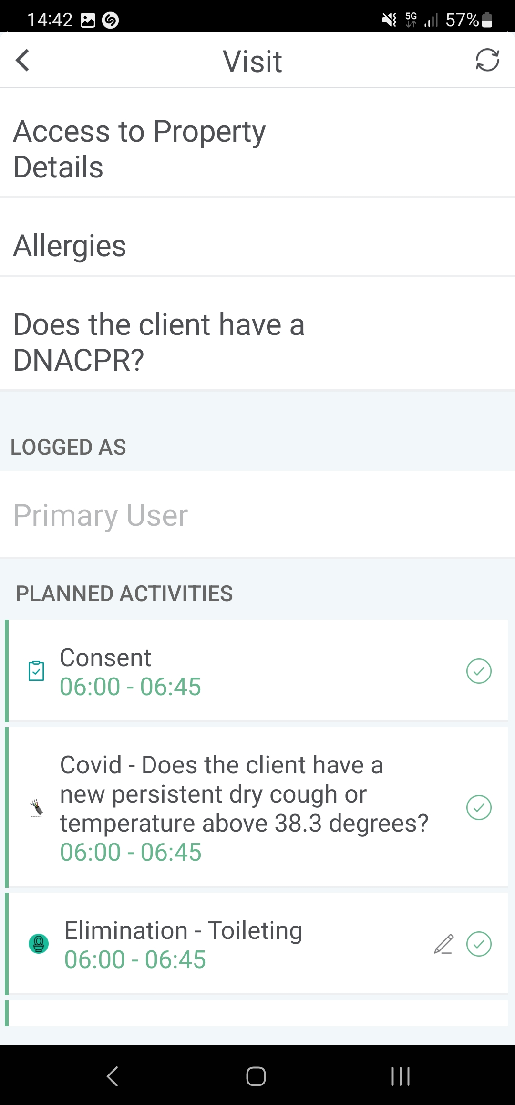
When pressed on a client
Go Back
Client’s name
Refresh button
Visit 30 minutes
When pressed, it would log into the system the time the carer press start, it would turn into End Visit button, and when pressed will log the time
12/Feb 06:00 - 06:30 (time requested)
12/Feb 06:12 - 06:40 (times that carer logged in and logged out)
Address of client
Previous & Later Visits
Blank text box to add further comments
Start Visit button
This is how it would look like on a very basic level when scrolling down the page

Slide 4
When pressed Incident Form
It should be Text Boxes for each of them, so the carer can manually add a new medication in the system.
Date actioned
Actioned by
Name on label
Frequency
Dose
Start date on label
Expiry date on label
Other special indications
When pressed Submit, the details should go into database and then added as a Task into Client’s page
Submit button

